Slide 1
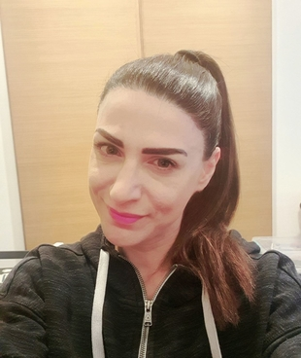


Hello, again children!
“Hello, friends!”

Slide 2
Do you want to sing and dance with me?
Good morning
dance
Good morning
song

Slide 3
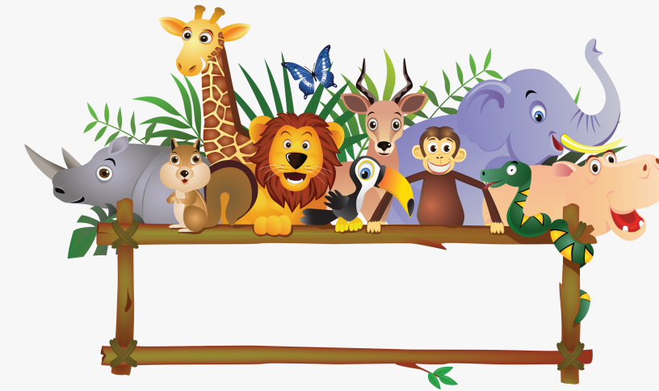
ANIMALS

Slide 4
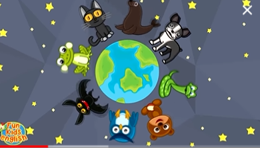

Let’s hear ‘’I like animals” song!
I Like Animals | Animals Song for Kids | Learn 12 Animal Names | ESL for Kids | Fun Kids English - YouTube

Slide 5
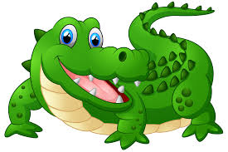
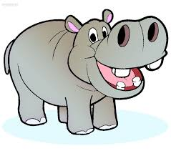
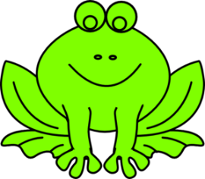
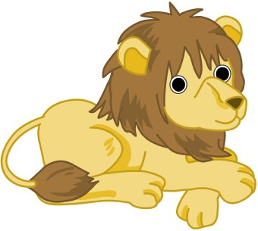
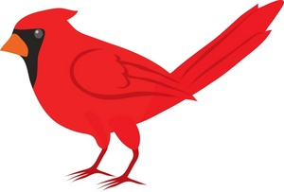
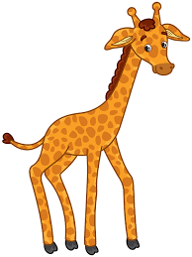
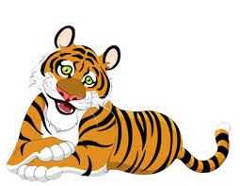
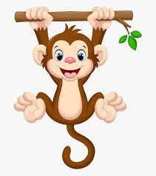
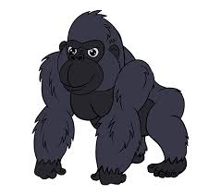
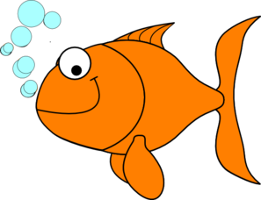
Listen, point and say!
bird
crocodile
hippo
frog
lion
monkey
giraffe
gorilla
tiger
fish

Slide 6
Let’s play a game! Guess the animal!
bird
crocodile
hippo
frog
lion
monkey
giraffe
gorilla
tiger
fish

Slide 8
crocodile

Slide 10
tiger

Slide 12
fish

Slide 14
bird

Slide 15
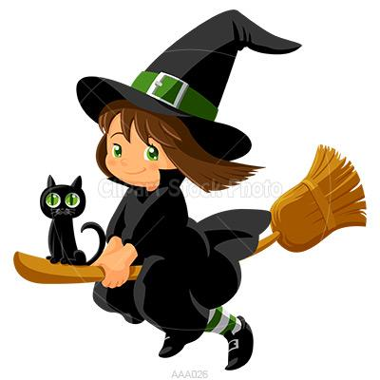
Hello, children! Remember me? I’m Mia Mia! Are you ready to play our game?

Slide 16
Let’s say the words together to remember them!
bird
crocodile
hippo
frog
lion
monkey
giraffe
gorilla
tiger
fish

Slide 17

I throw magic dust!
bird
crocodile
hippo
frog
lion
monkey
giraffe
gorilla
tiger
fish

Slide 18
Open your eyes!
What is missing?
bird
crocodile
hippo
lion
monkey
giraffe
gorilla
tiger
fish

Slide 19
frog

Slide 20
bird
crocodile
hippo
frog
lion
monkey
giraffe
gorilla
tiger
fish

Slide 21
What is missing?
bird
crocodile
hippo
frog
lion
giraffe
gorilla
tiger
fish

Slide 22
monkey

Slide 23
bird
crocodile
hippo
frog
lion
monkey
giraffe
gorilla
tiger
fish

Slide 24
What is missing?
bird
crocodile
hippo
frog
lion
monkey
giraffe
gorilla
fish

Slide 25
tiger

Slide 26
One last time! Level 2! Two words!
bird
crocodile
hippo
frog
lion
monkey
giraffe
gorilla
tiger
fish

Slide 27
What words are missing?
bird
crocodile
frog
lion
monkey
gorilla
tiger
fish

Slide 28
hippo
giraffe

Slide 29
Oh no! You won again! I ‘m going home!!!

Slide 30

Click and play a memory game!
Wild Animals2 - Matching pairs (wordwall.net)

Slide 31
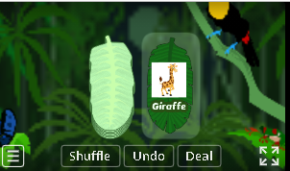
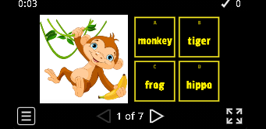
Wow! More animal games!!
Turn over the card and say the animal
Animal Quiz!
Wild Animals - Random cards (wordwall.net)
Wild Animals - Quiz (wordwall.net)

Slide 32
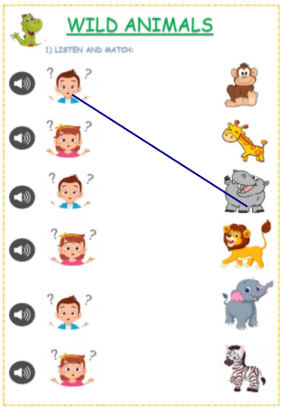
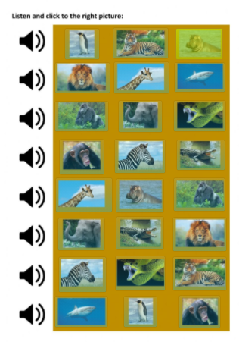
Now that you know the animals really well, you can practice some more!!
Listen and match!
Listen and click to the right picture!
Wild animals online exercise for Elementary (liveworksheets.com)
Wild animals interactive activity for Grade 1, 2 (liveworksheets.com)

Slide 33
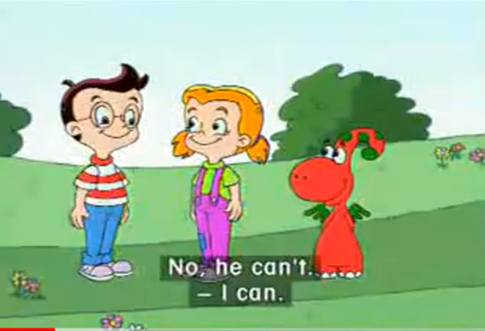
Hello again, Gogo!
Gogo, can you run?
Gogo, can you swim? ☺
Gogo 16 I can swim. - YouTube

Slide 34
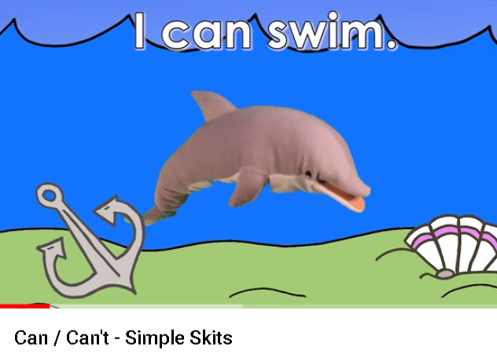
Let’s watch a funny video! What can our friends do?
Can / Can't - Simple Skits - YouTube

Slide 35
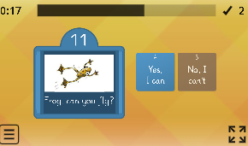
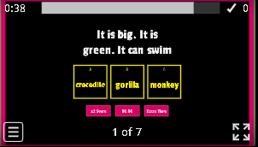
Yay! More games to practice! I love games!
Open the box and answer the question
Quiz show
Animals. It can... - Gameshow quiz (wordwall.net)
Animals: ....can you...?2 - Open the box (wordwall.net)

Slide 36
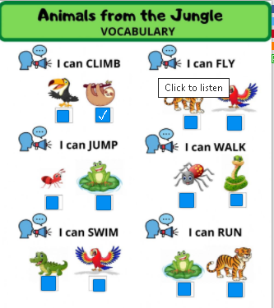
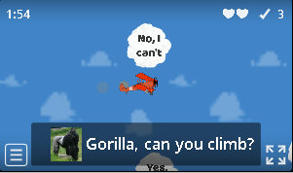
Drive the airplane to the cloud with the right answer
Click on the speaker and then tick the right box. Click finish to check your answers.
Animals: ....can you...?2 - Airplane (wordwall.net)
What Can Animals Do? exercise (liveworksheets.com)

Slide 37
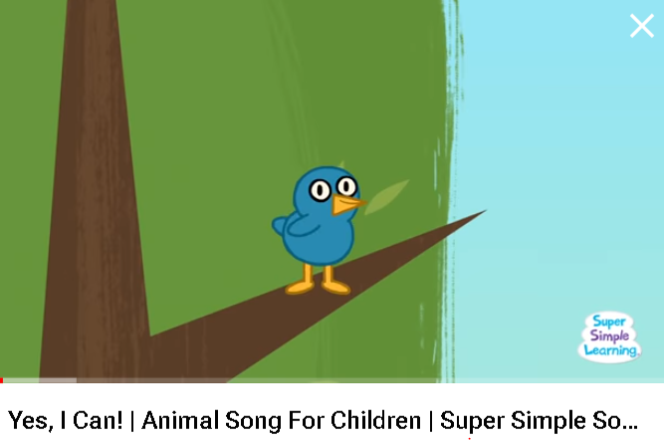
Let’s finish our lesson with a song!
Yes, I Can! | Animal Song For Children | Super Simple Songs - YouTube

Slide 38



Thank you very much children!
Goodbye friends!

