Slide 1
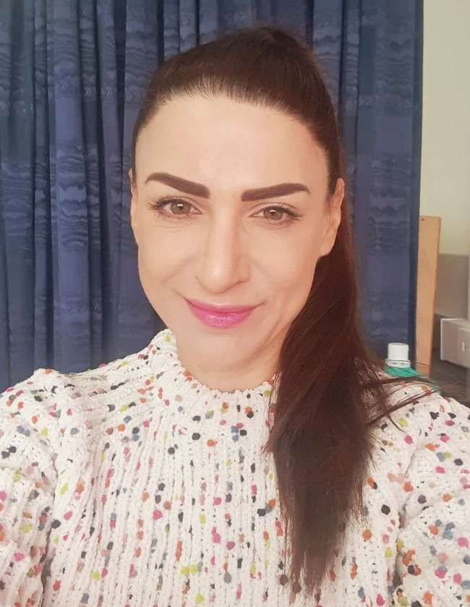
Hello again, children! How are you today?

Slide 2
Are you ready for the “Good morning” dance and song?
Good morning
dance
Good morning
song

Slide 3
Numbers

Slide 4
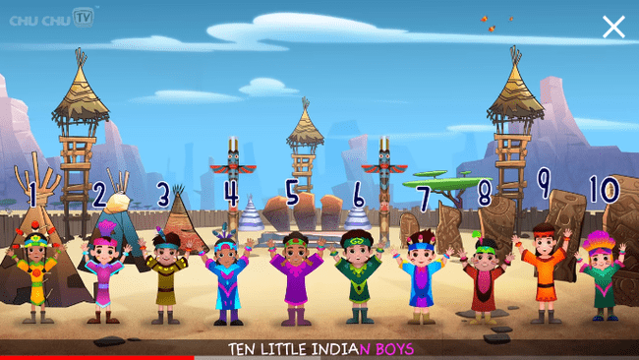
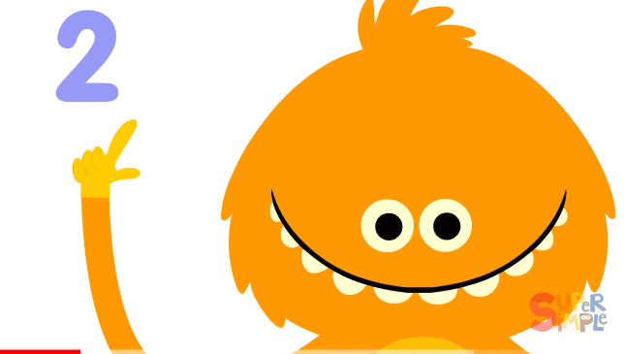
Let’s hear two songs to remember numbers 1-10!
How Many Fingers? | Kids Songs | Super Simple Songs - YouTube
Ten Little Indians Nursery Rhyme | Popular Number Nursery Rhymes For Children by ChuChu TV - YouTube

Slide 5
Listen, point and repeat!
zero
one
two
three
four
five
six
seven
eight
nine
ten

Slide 6
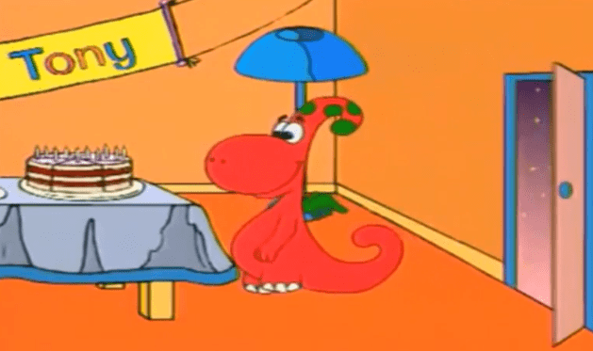
Do you remember our friend Gogo? Let’s watch a funny video with him to practice numbers!
English Kids Academy Gogo's Adventure Unit 4 Numbers - YouTube

Slide 7
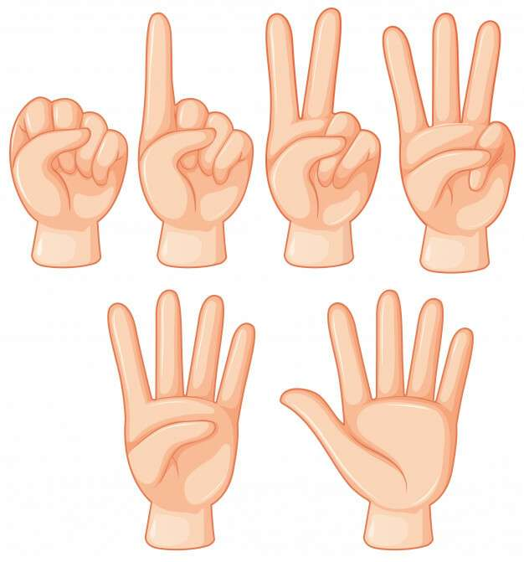
GAME
HOW MANY
FINGERS?

Slide 8
How many fingers? Can you say the number?

Slide 9
five

Slide 10
How many fingers?

Slide 11
three

Slide 12
How many fingers this time?

Slide 13
eight

Slide 14
What about now?
How many fingers?

Slide 15
zero

Slide 16
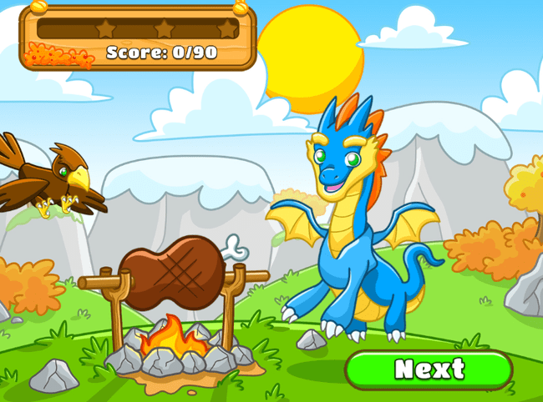
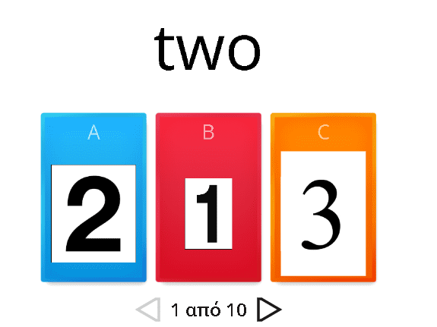
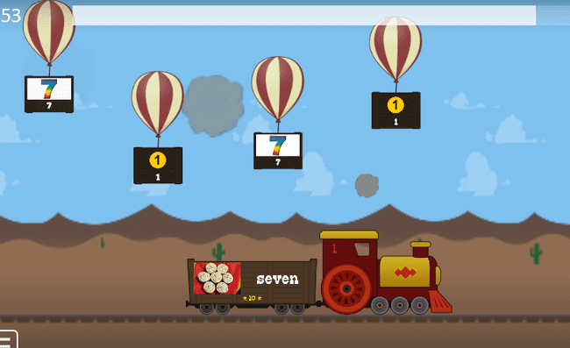
Click and play fun games to practice numbers 1-10!
numbers - Κουίζ (wordwall.net)
https://www.eslgamesplus.com/numbers-1-to-10-esl-fun-game-catapult-game/
Numbers 1-10 - Μπαλόνια (wordwall.net)

Slide 17
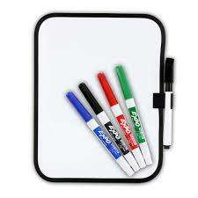
Take a piece of paper or your whiteboard. Say and if you can write down the number on the dice!

Slide 18
What is the number on the dice?
six

Slide 19
What is the number now?
four

Slide 20
What about this time?
seven

Slide 21
What is the number here?
ten

Slide 22
One last time!
eight

Slide 23
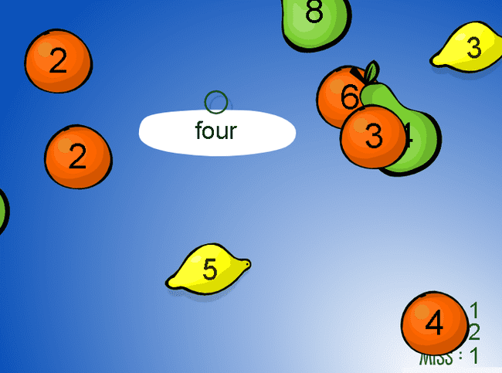
Let’s play again!
How fast can you shoot the right number?
Number Words - Early Math- Fruit Splat Game - Math Game (sheppardsoftware.com)

Slide 24
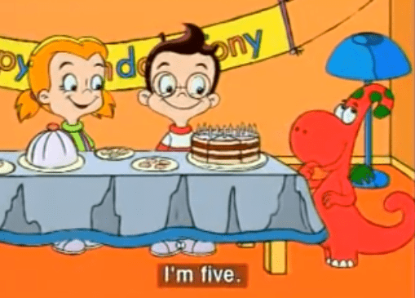
Happy birthday Tony!
How old is Tony?
Watch the next video to remember how old is Tony, Gogo and Jenny!

Slide 26
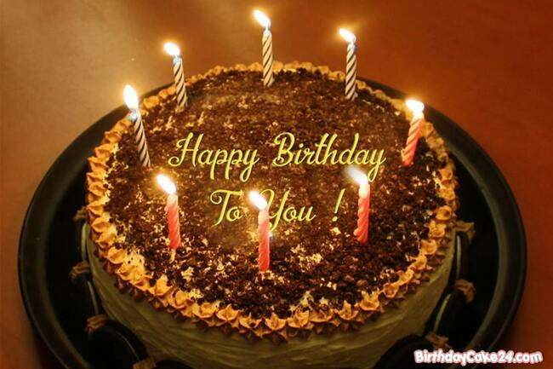
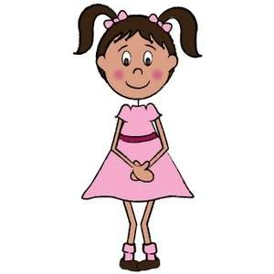
How old is Emma?
Click on the right answer.
I’m eight
I ‘m ten

Slide 29
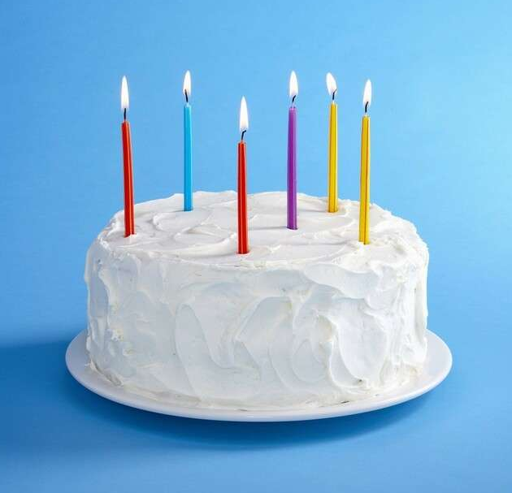
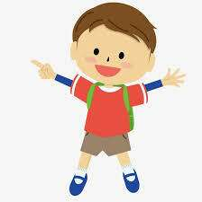
How old is Jason?
I’m five
I’m six

Slide 32
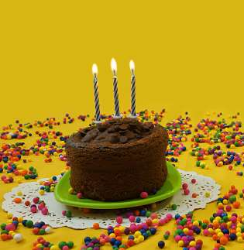
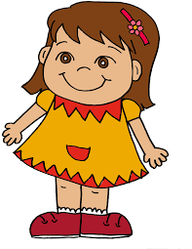
How old is Roza?
I’m two
I’m three

Slide 35
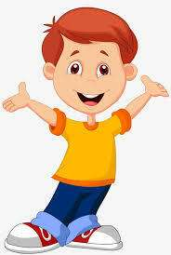
How old is Peter?
I’m eight
I’m ten

Slide 38
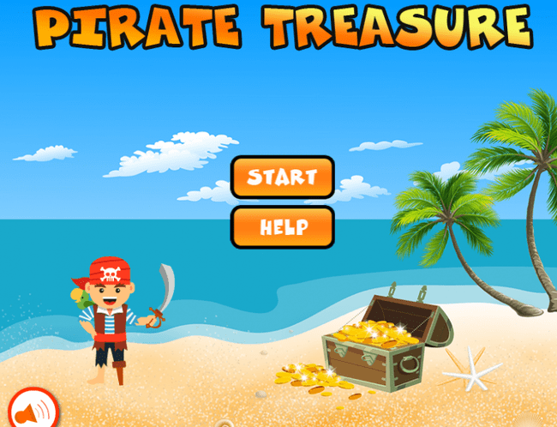
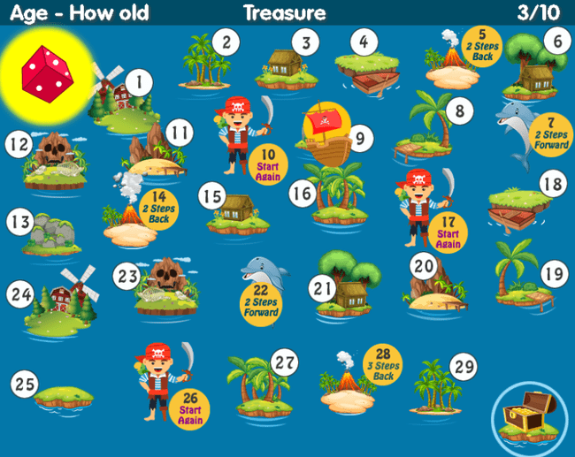
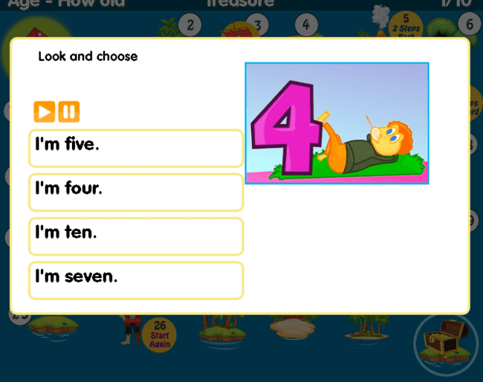
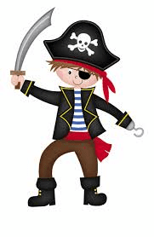
The pirate board game! “How old are you?” – “How old is she?- How old is he?”.
Click on the link and then click on the dice to play!
https://www.eslgamesplus.com/age-how-old-esl-interactive-board-game/

Slide 39
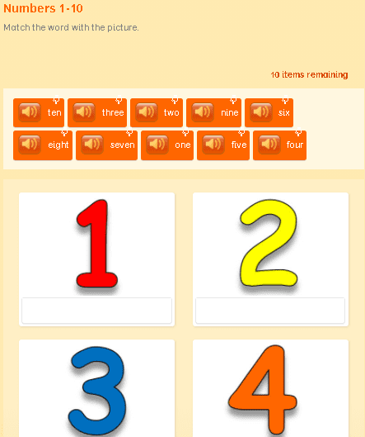
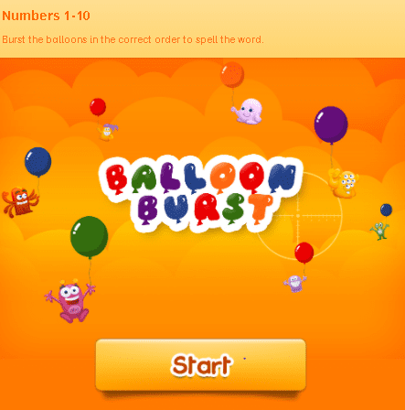
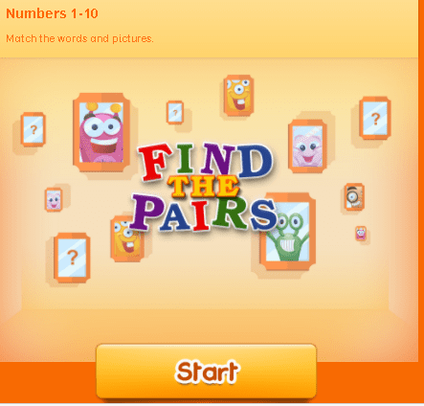
Wow! More games! Choose what you want to play!
Numbers 1-10 | LearnEnglish Kids | British Council

Slide 40
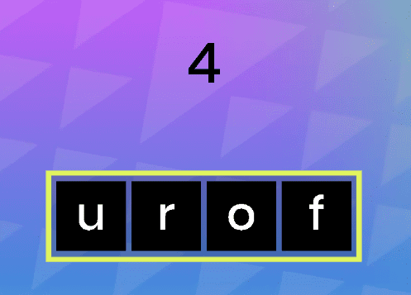
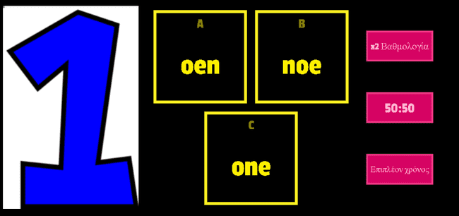
Numbers 1-10 - Τηλεπαιχνίδι (wordwall.net)
Spell the number words 0-10 - Αναγραμματισμός (wordwall.net)
https://www.agendaweb.org/exercises/vocabulary/audio/numbers-1
Numbers 1-10 (Unscramble) worksheet (liveworksheets.com)
https://agendaweb.org/exercises/vocabulary/numbers-1-10
https://agendaweb.org/exercises/vocabulary/numbers-write

Slide 41
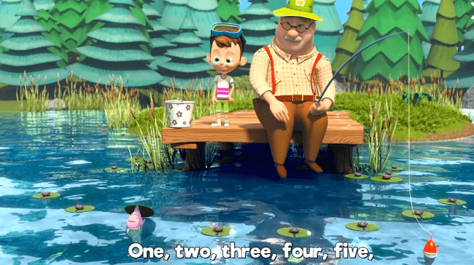
Time to say goodbye with a song!
Let’s sing along!
🐟 Once I Caught a Fish Alive 🐟 THE BEST Songs for Children | LooLoo Kids - YouTube

Slide 42
Thank you very much children!
Goodbye friends!

