Slide 1
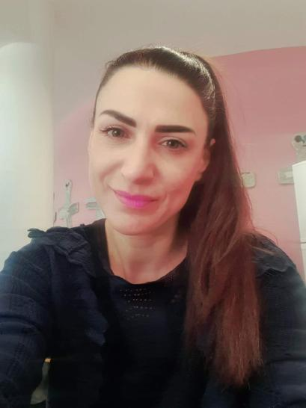

Hello, children!
Let’s sing “Hello, friends!”

Slide 2

Are you ready for the “Good morning” dance and song?
Good morning
dance
Good morning
song

Slide 3
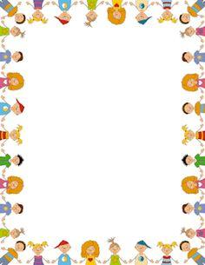
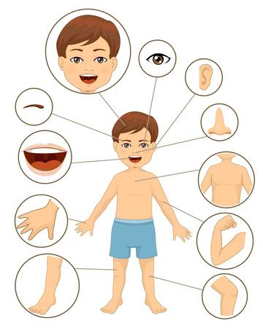

Slide 4
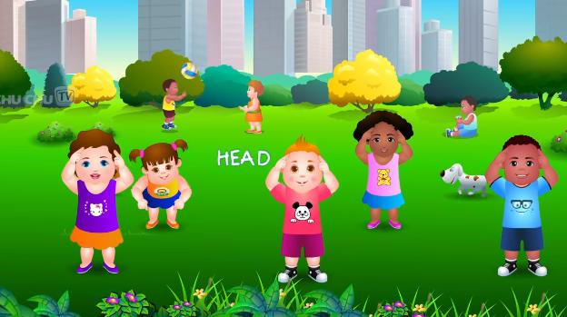

Let’s sing ‘’Head and shoulders, knees and toes!”
Head, Shoulders, Knees & Toes - Exercise Song For Kids - YouTube

Slide 5
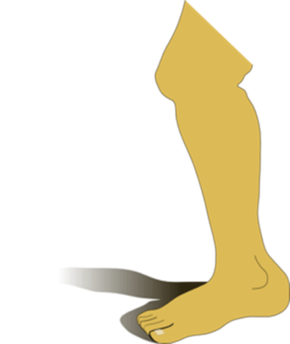
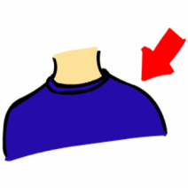



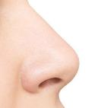
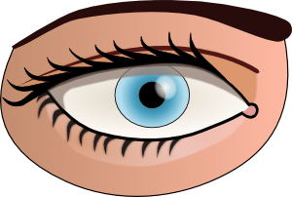

Listen, point and say!
toes
head
shoulder
knee
eye
ear
mouth
nose

Slide 6
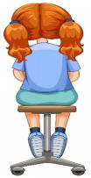
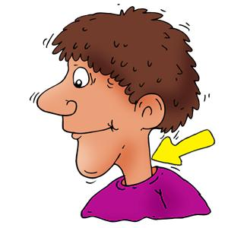
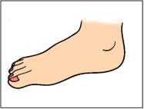

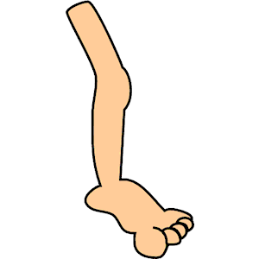
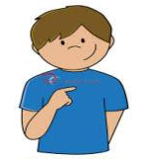
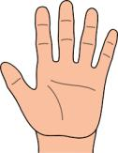
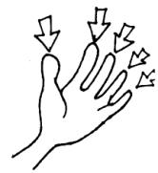
Let’s remember some more body parts!
neck
foot
arm
back
leg
chest
hand
fingers

Slide 7
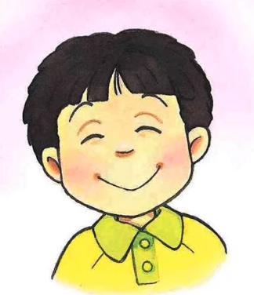
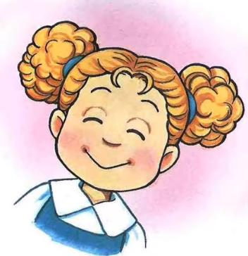
Eyes, nose, mouth and ears make a happy face! ☺
Eyes Nose Mouth Ears - Song - YouTube

Slide 8
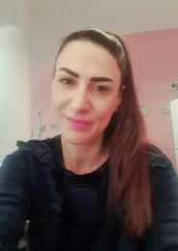
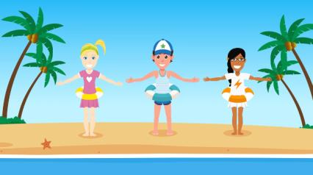

Here are two songs to help us learn the parts of the body in a fun way!
Parts of the Body Song - YouTube
Body Parts Song for Kids - This is ME! by ELF Learning - ELF Kids Videos - YouTube

Slide 9
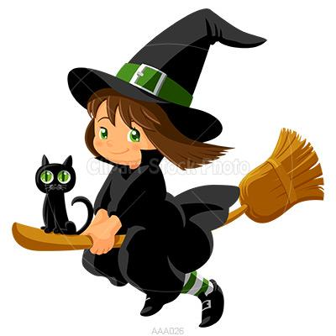
Hello, children! Remember me? I’m Mia Mia! Are you ready to play our game?

Slide 10

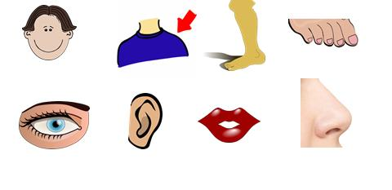
I throw magic dust!
toes
head
shoulder
knee
eye
ear
mouth
nose

Slide 11

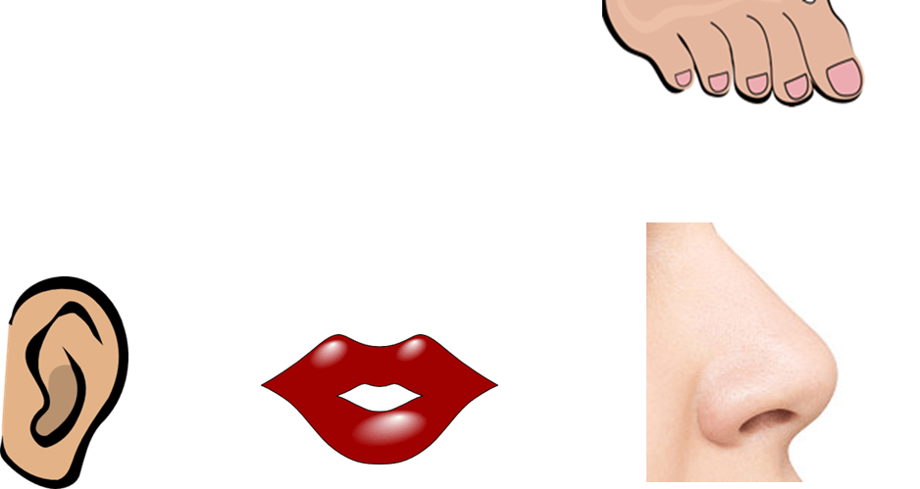
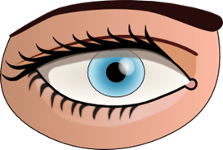
Open your eyes!
What is missing?
shoulder
toes
head
eye
ear
mouth
nose

Slide 12

knee

Slide 13
toes
head
shoulder
knee
eye
ear
mouth
nose

Slide 14
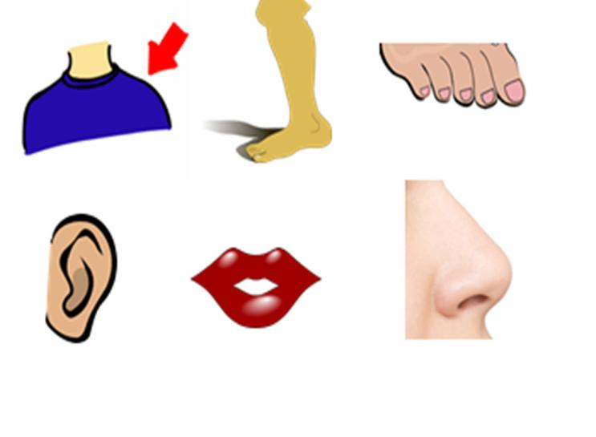
What is missing?
toes
shoulder
knee
eye
ear
mouth
nose

Slide 15
head

Slide 16
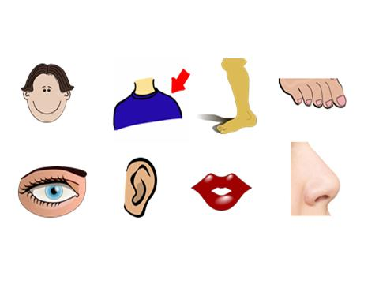
toes
head
shoulder
knee
mouth
eye
ear
nose

Slide 17
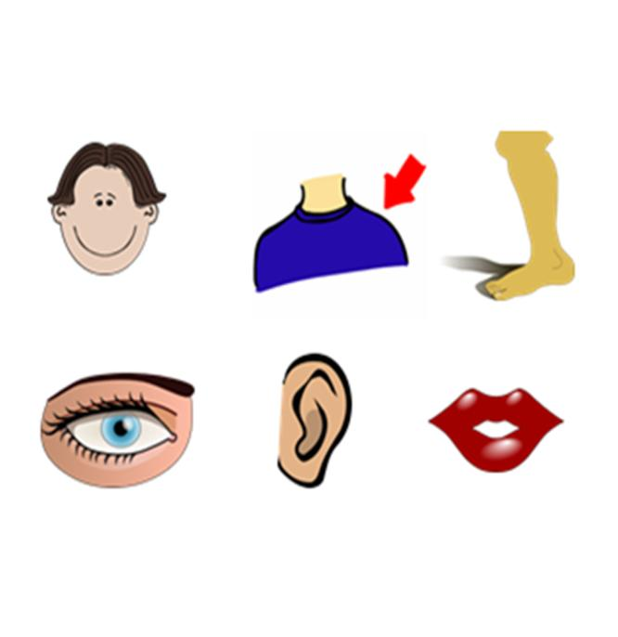

What is missing?
toes
head
shoulder
knee
eye
ear
mouth

Slide 18

nose

Slide 19
Let’s play with the other words now!
neck
foot
arm
back
leg
chest
hand
fingers

Slide 20
What is missing?
neck
foot
arm
leg
chest
hand
fingers

Slide 21

back

Slide 22
neck
foot
arm
back
leg
chest
hand
fingers

Slide 23
What is missing?
foot
arm
back
leg
chest
hand
fingers

Slide 24
neck

Slide 25
One last time! Level 2! Two words!
neck
foot
arm
back
leg
chest
hand
fingers

Slide 26
What words are missing?
back
neck
leg
chest
hand
fingers

Slide 27

arm
foot

Slide 28
Oh no! You won again! I ‘m going home!!!

Slide 29
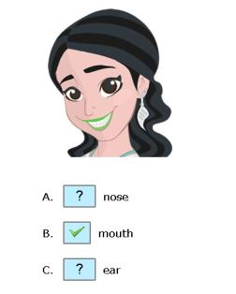
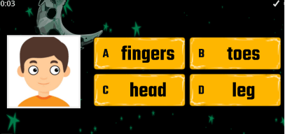
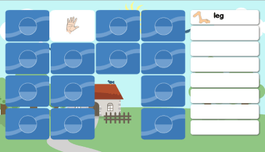
Click to play fun games to practice the Parts of the Body!
Parts of the head - vocabulary exercises. (agendaweb.org)
Body parts - Κουίζ (wordwall.net)
ESL Fun Vocabulary Games,Body Parts Memory Game (eslgamesworld.com)

Slide 30
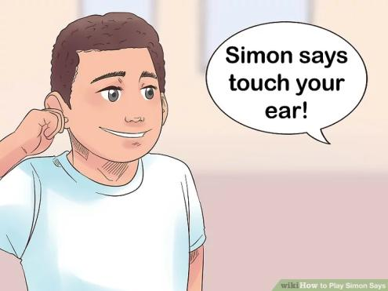
Hey! Let’s play “Simon says”!

Slide 31
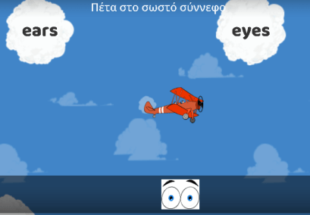
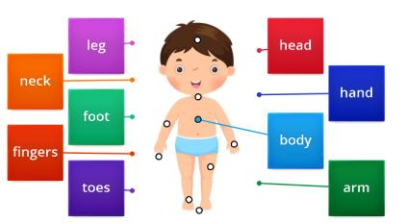
Wow!!! More games!
Parts of the body Go getter 1 Unit 4.2 - Διάγραμμα με πινέζες (wordwall.net)
Parts of the body - Αεροπλάνο (wordwall.net)

Slide 32

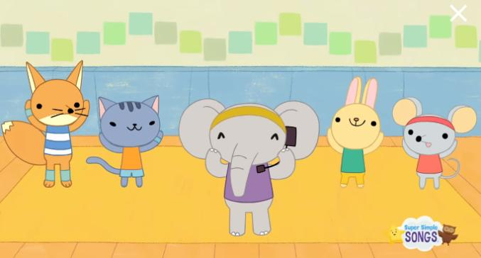
Can you sing “Head, shoulders, knees and toes” faster and faster and faster?
Head Shoulders Knees & Toes (Speeding Up) | Nursery Rhyme | Super Simple Songs - YouTube

Slide 33

GAME
Find the
right monster

Slide 34

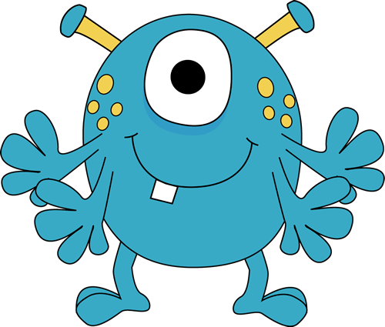
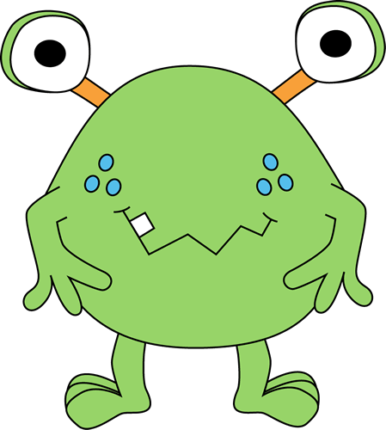
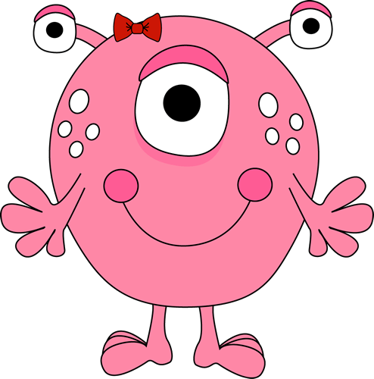
Listen and click on the right monster.

Slide 35


Slide 36



Slide 37
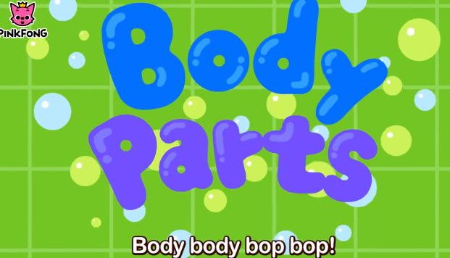
Let’s finish the lesson with a really funny song.
Hello, My Body! | Body Parts Songs | Pinkfong Songs for Children - YouTube

Slide 38

Well done!

Slide 39

http://www.clker.com
https://images.app.goo.gl/rdPYg7tRaJNjFsMg7
https://images.app.goo.gl/8Bfx5i28yNBJR3s18
http://clipart-library.com/

