Slide 1

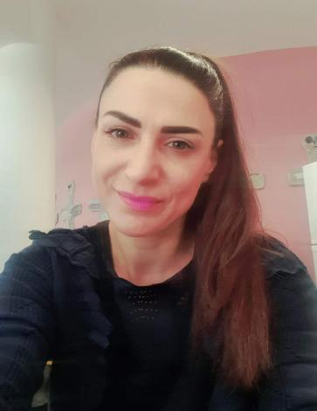
Αγαπημένα μου παιδάκια, γεια σας!
Αυτή τη φορά σας στέλνω μερικά παιχνιδάκια και τραγουδάκια για να θυμηθούμε τα ζωάκια που μάθαμε στην τάξη στο τελευταίο μας μάθημα.
Την επόμενη εβδομάδα θα κάνουμε και εμείς διαδικτυακό μάθημα στα Αγγλικά και είμαι πολυυυύ χαρούμενη γι’ αυτό!!! 😊

Slide 2

Hello, friends!
Notes:
2

Slide 3
Are you ready for the “Good morning” dance and song?
Good morning
dance
Good morning
song
Notes:
3

Slide 4
Let’s remember the animals!
Repeat after me!

Slide 5
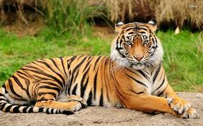
tiger

Slide 6
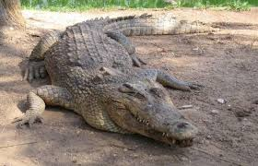
crocodile

Slide 7
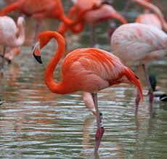
flamingo

Slide 8
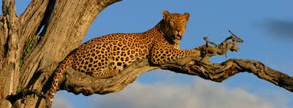
leopard

Slide 9
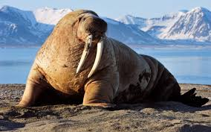
walrus

Slide 10
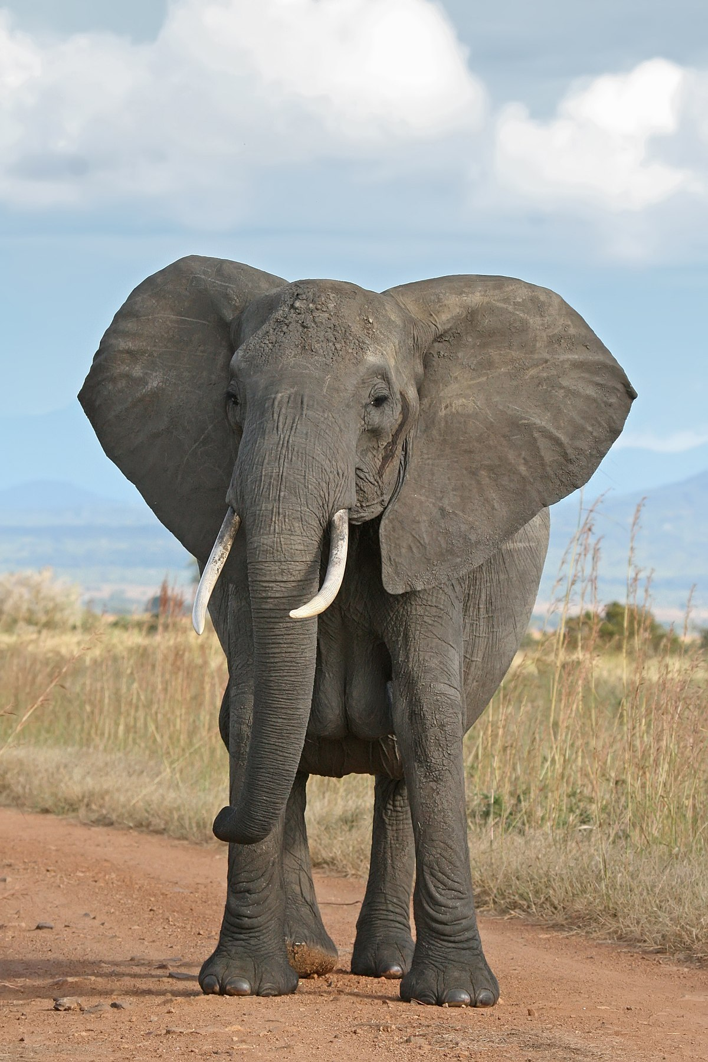
elephant

Slide 11
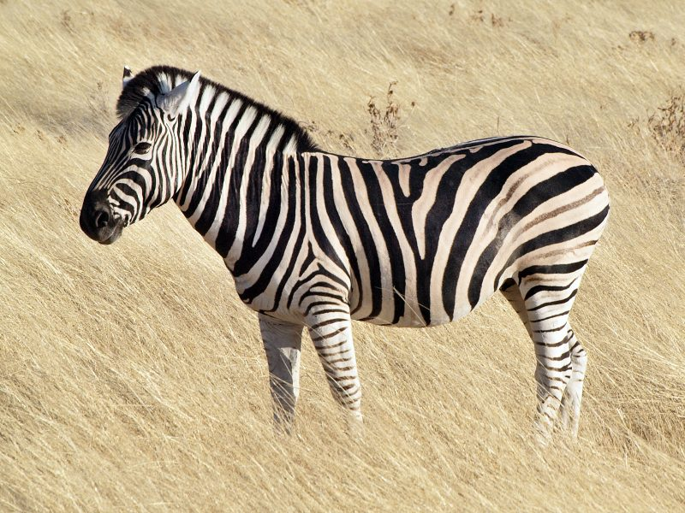
zebra

Slide 12
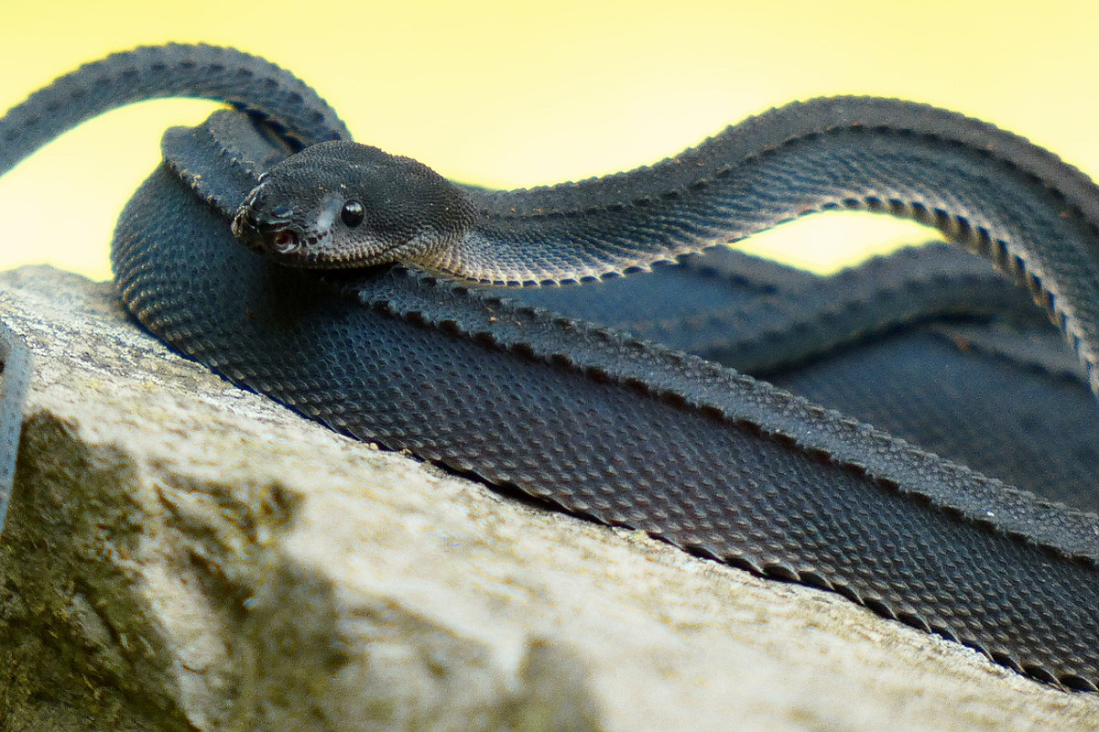
snake

Slide 13
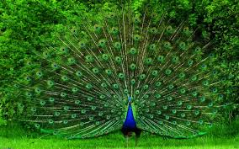
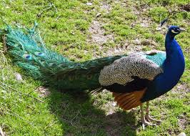
peacock

Slide 14
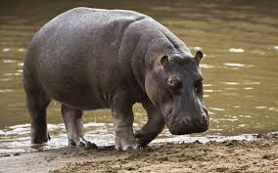
hippo

Slide 15
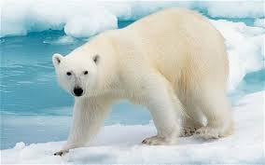
polar bear

Slide 16


Slide 17
tiger

Slide 18
crocodile

Slide 19
flamingo

Slide 20
leopard

Slide 21
walrus

Slide 22
elephant

Slide 23
zebra

Slide 24
snake

Slide 25
peacock

Slide 26
hippo

Slide 27
polar bear

Slide 28


Slide 29
tiger

Slide 30
crocodile

Slide 31
flamingo

Slide 32
leopard

Slide 33
walrus

Slide 34
elephant

Slide 35
zebra

Slide 36
snake

Slide 37
peacock

Slide 38
hippo

Slide 39
polar bear

Slide 40
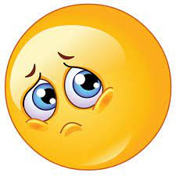

Slide 41
tiger

Slide 42
crocodile

Slide 43
flamingo

Slide 44
leopard

Slide 45
walrus

Slide 46
elephant

Slide 47
zebra

Slide 48
snake

Slide 49
peacock

Slide 50
hippo

Slide 51
polar bear

Slide 52
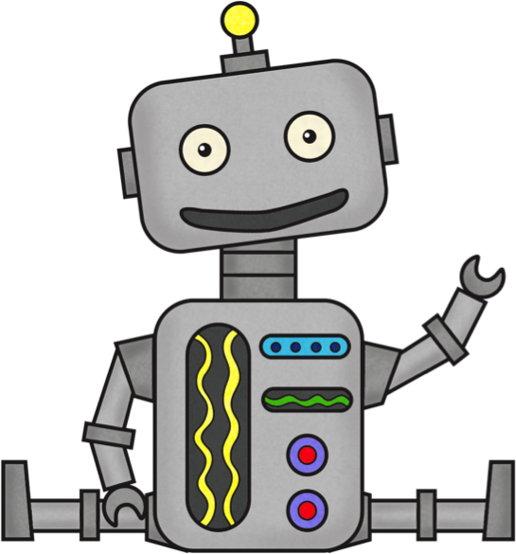

Slide 53
tiger

Slide 54
crocodile

Slide 55
flamingo

Slide 56
leopard

Slide 57
walrus

Slide 58
elephant

Slide 59
zebra

Slide 60
snake

Slide 61
peacock

Slide 62
hippo

Slide 63
polar bear

Slide 64
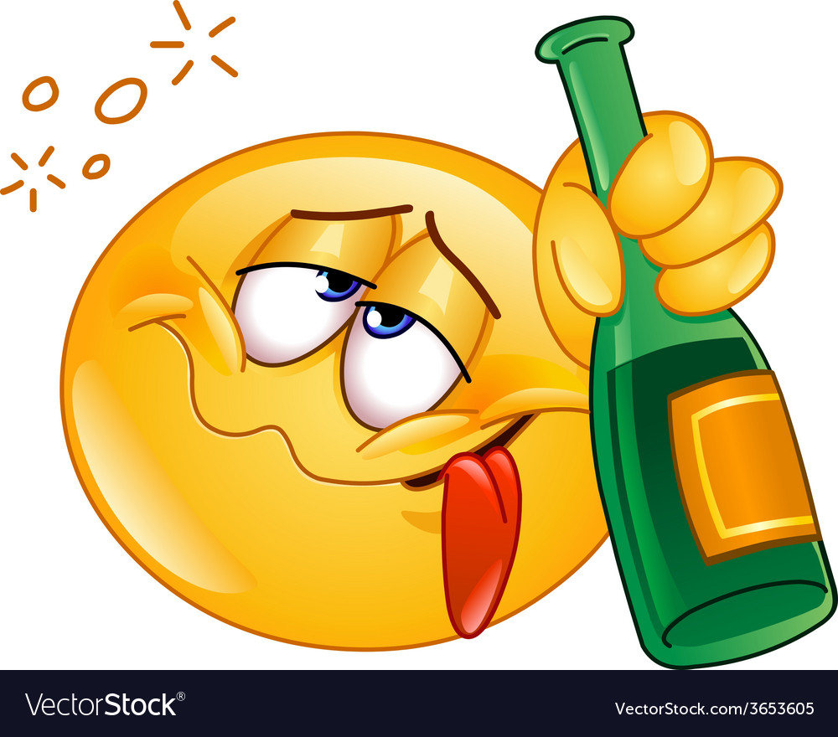

Slide 65
tiger

Slide 66
crocodile

Slide 67
flamingo

Slide 68
leopard

Slide 69
walrus

Slide 70
elephant

Slide 71
zebra

Slide 72
snake

Slide 73
peacock

Slide 74
hippo

Slide 75
polar bear

Slide 76
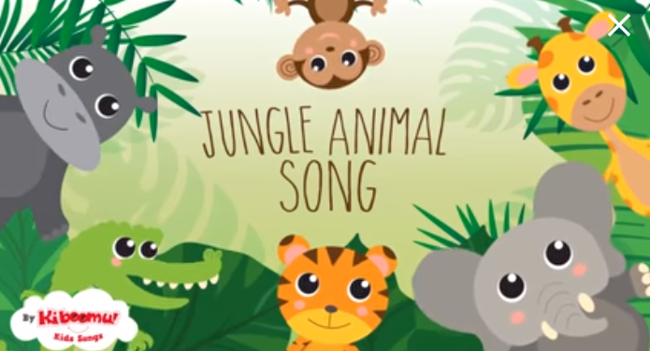

Let’s sing “The jungle animals” song!
Jungle Animals Song | Kids Songs | Nursery Rhymes | The Kiboomers - YouTube
Notes:
76

Slide 77
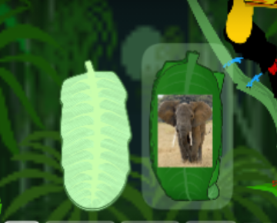
Time for games! Click, turn the leaf card and say the animal!
Polar bear what do hear Animals Y1 - Random cards (wordwall.net)

Slide 78
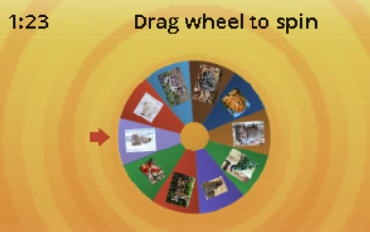
Wow! Another game! Click on the link then spin the wheel and say the animal!
Polar bear what do hear Animals - Random wheel (wordwall.net)

Slide 79
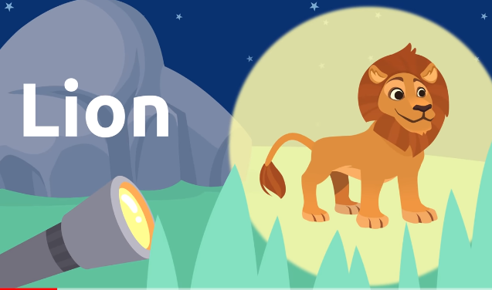
What animal is it?
Wild animals for kids - Vocabulary for kids - YouTube

Slide 80
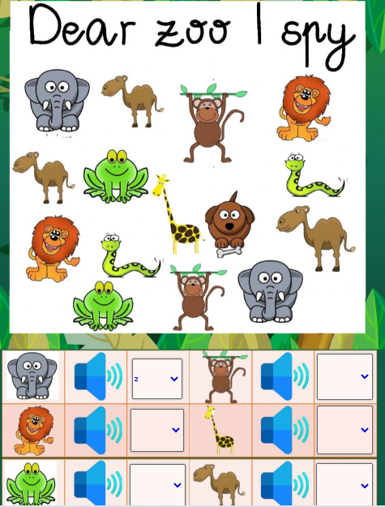
How many elephants? One, two or three?
Count the animals and choose the correct number!
I spy dear zoo worksheet (liveworksheets.com)

Slide 81

Thank you very much children! See you next week! Goodbye friends!

