Slide 1
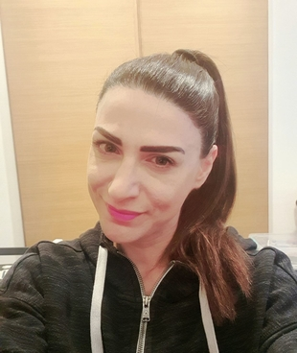


Hello, again children!
“Hello, friends!”

Slide 2
Do you want to sing and dance with me?
Good morning
dance
Good morning
song

Slide 3
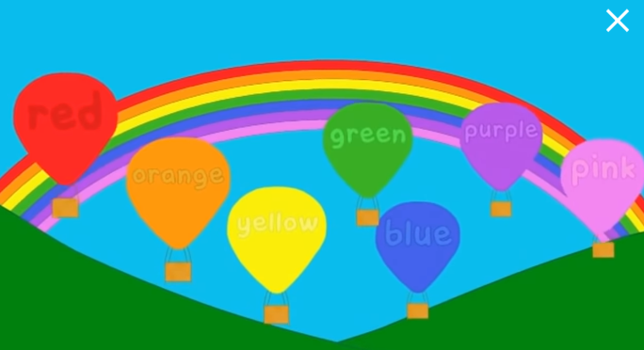

The “Rainbow song”! Our favourite!
The Rainbow Colors Song - YouTube

Slide 4
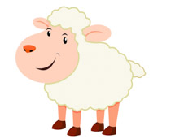
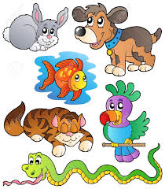
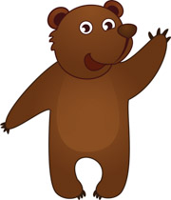
ANIMALS

Slide 5

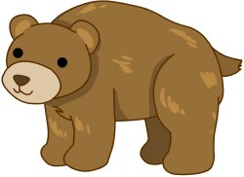
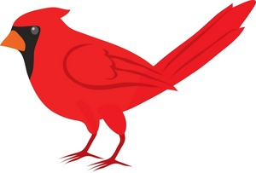

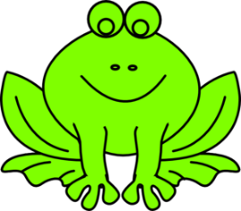
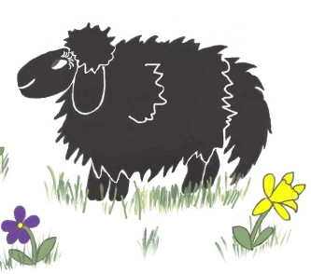

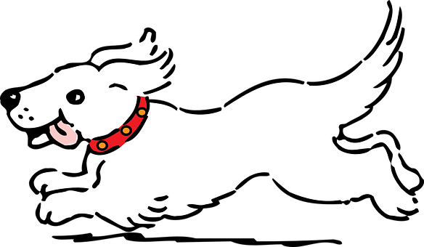
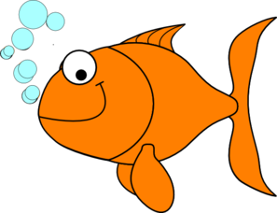
Listen, point and say!

Slide 6
Let’s play a game! Guess the animal!

Slide 15
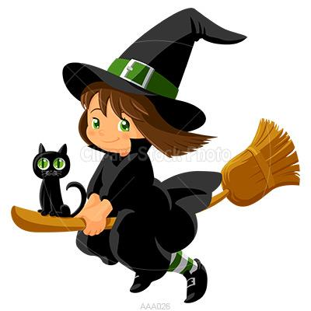
Hello, children! Remember me? I’m Mia Mia! Are you ready to play our game?

Slide 16
Let’s say the words together to remember them!

Slide 17

I throw magic dust!

Slide 18
Open your eyes!
What is missing?

Slide 19
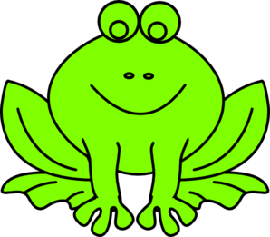

Slide 21
What is missing?

Slide 24
What is missing?

Slide 26
One last time! Level 2! Two words!

Slide 27
What words are missing?

Slide 29
Oh no! You won again! I ‘m going home!!!

Slide 30
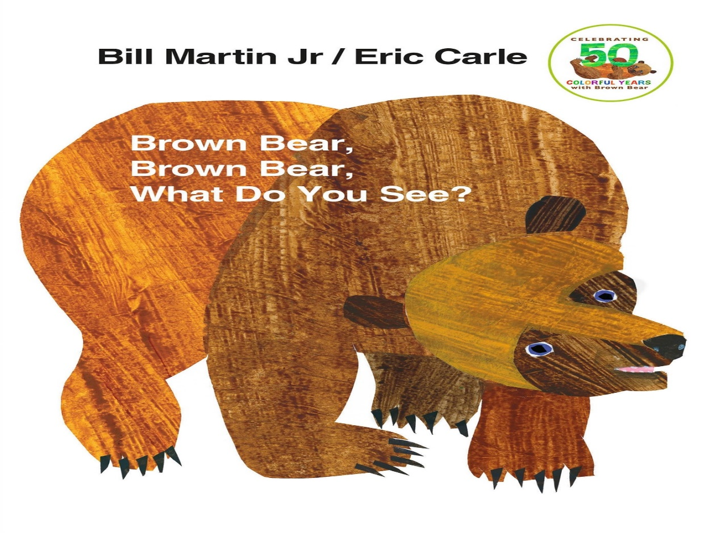
Storytime!!
Brown Bear, Brown Bear, What Do You See Read Aloud - YouTube

Slide 31
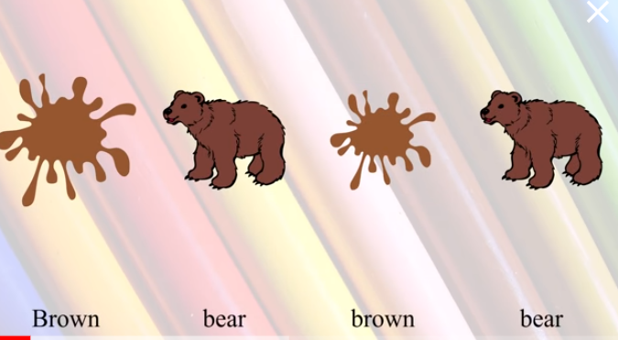
Let’s hear the story one more time with another funny video!
Brown Bear Brown Bear by Bill Martin Jr. and Eric Carle | Read Aloud with Pictures and Subtitles – YouTube

Slide 32

Click and play a memory game!
Animals - Matching pairs (wordwall.net)

Slide 33

GAME
Open the box and say the animal
https://wordwall.net/resource/10127190/animals-brown-bear-what-do-you-see-story-2

Slide 34
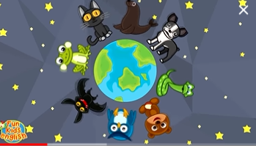
Let’s hear ‘’I like animals” song!
I Like Animals | Animals Song for Kids | Learn 12 Animal Names | ESL for Kids | Fun Kids English - YouTube

Slide 35



Thank you very much children!
Goodbye friends!

