Slide 1
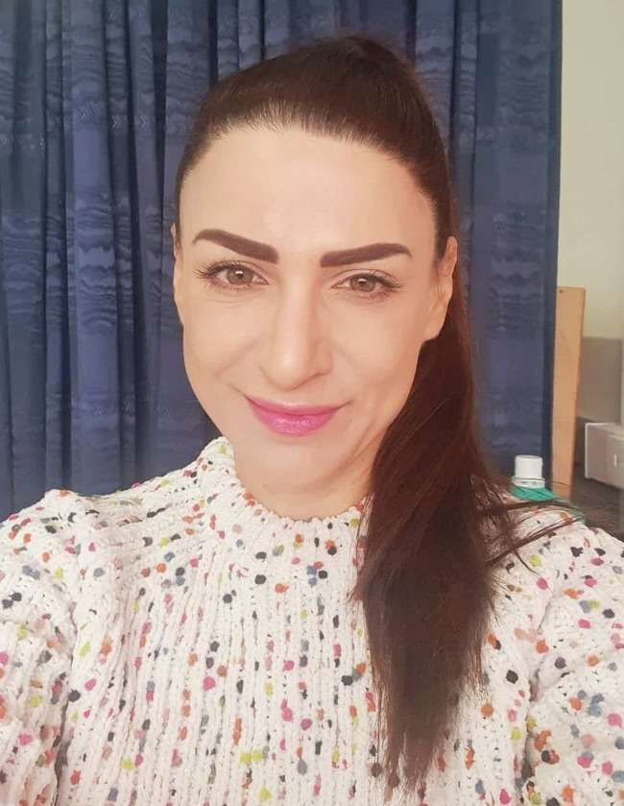
Hello again, children! How are you today?

Slide 2
Are you ready for the “Good morning” dance and song?
Good morning
dance
Good morning
song

Slide 3
Numbers

Slide 4
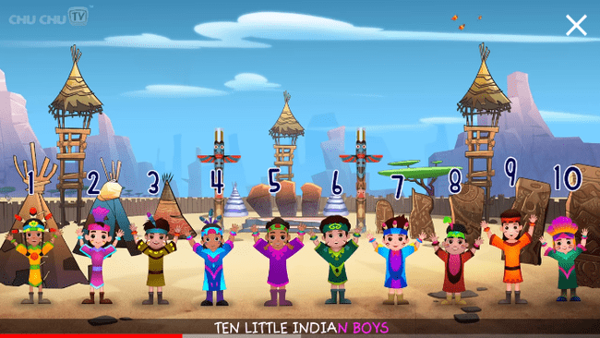
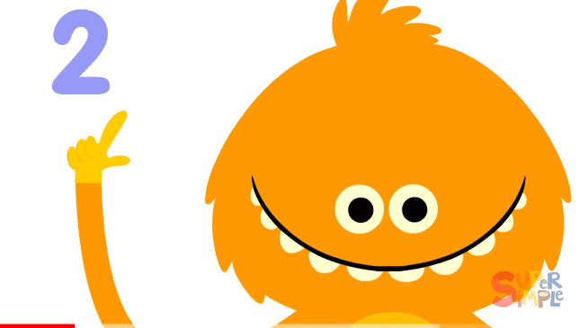
Let’s hear two songs to remember numbers 1-10!
How Many Fingers? | Kids Songs | Super Simple Songs - YouTube
Ten Little Indians Nursery Rhyme | Popular Number Nursery Rhymes For Children by ChuChu TV - YouTube

Slide 5
Listen, point and repeat!

Slide 6
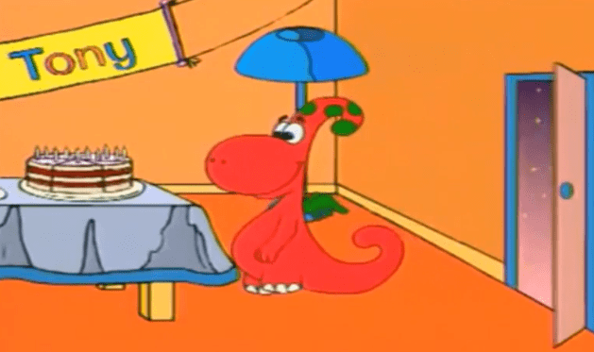
Do you remember our friend Gogo? Let’s watch a funny video with him to practice numbers!
English Kids Academy Gogo's Adventure Unit 4 Numbers - YouTube

Slide 7
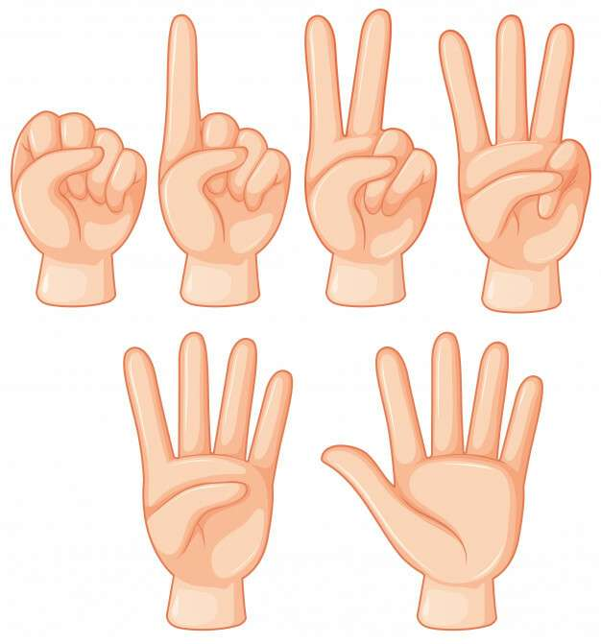
GAME
HOW MANY
FINGERS?

Slide 8
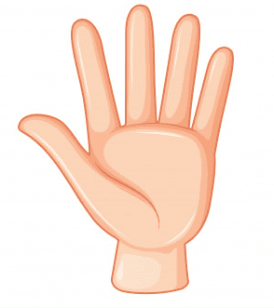
How many fingers? Can you say the number?

Slide 10
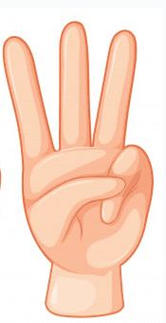
How many fingers?

Slide 12
How many fingers this time?

Slide 14
What about now?
How many fingers?

Slide 16
Click and play a memory game to practice numbers 1-10!
MEMORY GAME NUMBERS - Match The Memory

Slide 17
Now let’s play with the dice! What is the number on the dice? Can you say with a loud voice?

Slide 18
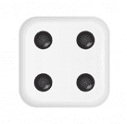
What is the number now?

Slide 19
What about this time?

Slide 20
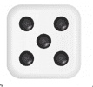
What is the number here?

Slide 21
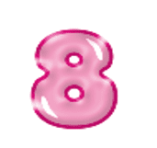
One last time!

Slide 22
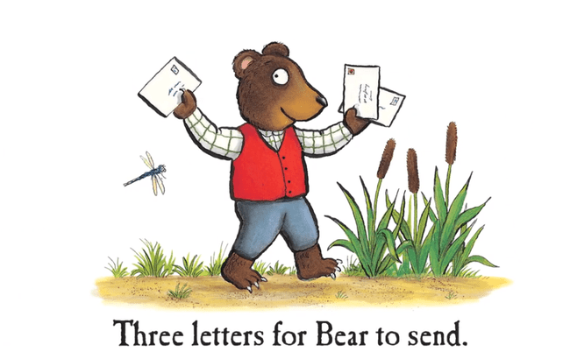
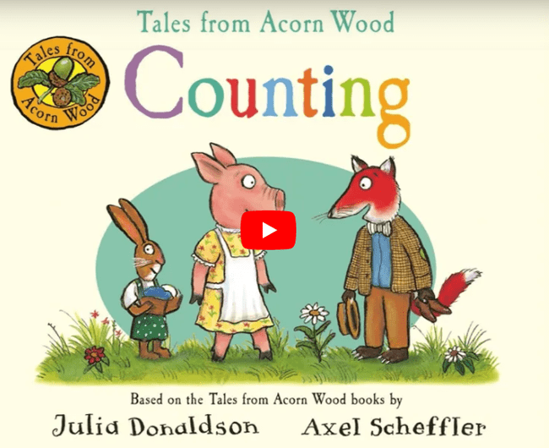
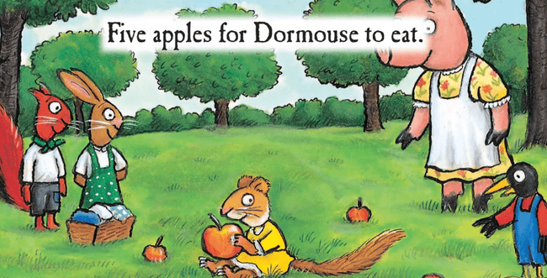
Story time! I love stories!
https://www.worldbookday.com/videos/acorn-wood-counting/

Slide 23
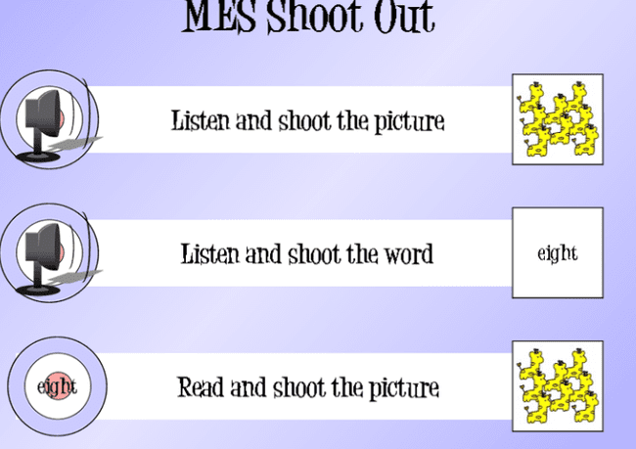
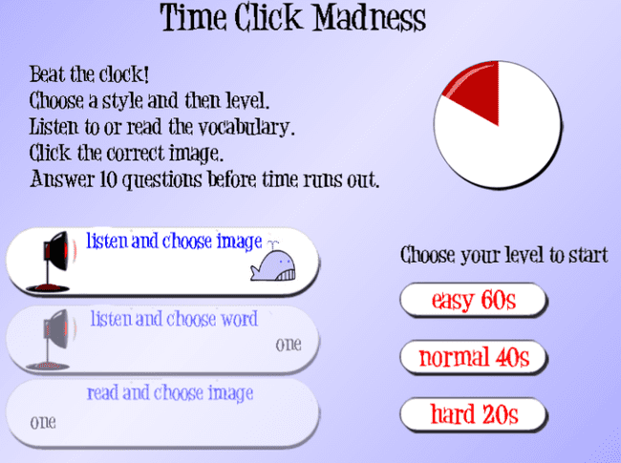
Click and play more games with numbers!
Numbers Games: 1-10 (mes-games.com)

Slide 24
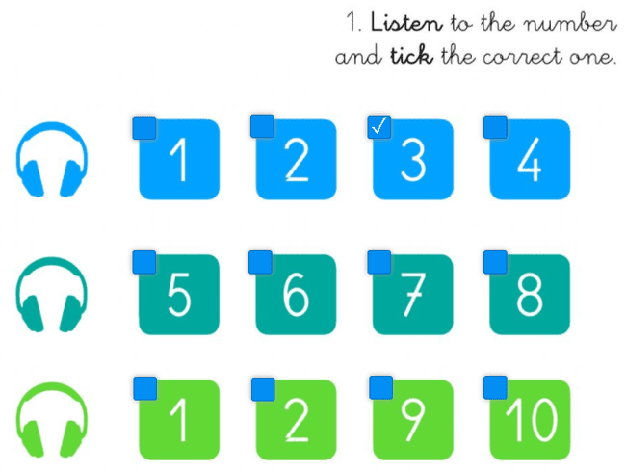
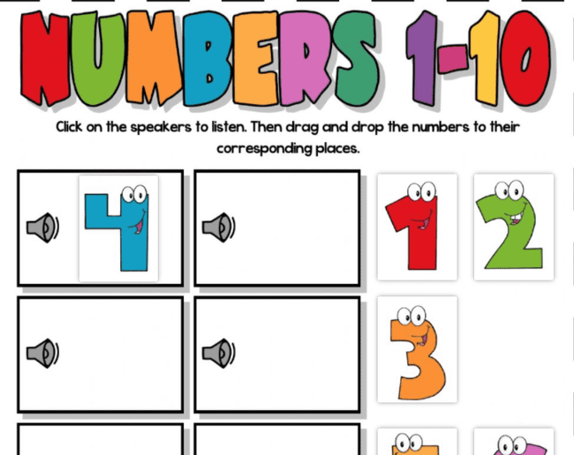
Wow! More games!!
Listening numbers 1-10 worksheet (liveworksheets.com)
Numbers 1-10 (listening) worksheet (liveworksheets.com)

Slide 25
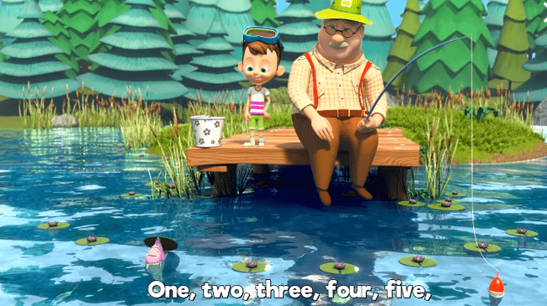
🐟 Once I Caught a Fish Alive 🐟 THE BEST Songs for Children | LooLoo Kids - YouTube
Time to say goodbye with a song!
Let’s sing along!

Slide 26
Thank you very much children!
Goodbye friends!

