Slide 1


Hello, children!
Let’s sing “Hello, friends!”

Slide 2

Are you ready for the “Good morning” dance and song?
Good morning
dance
Good morning
song

Slide 3
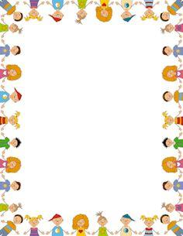
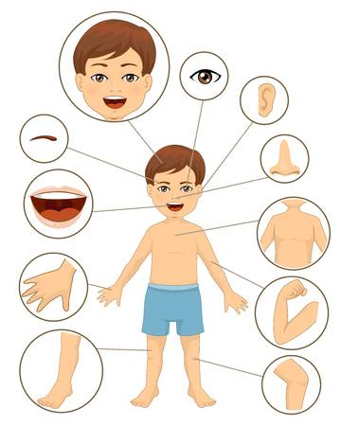

Slide 4
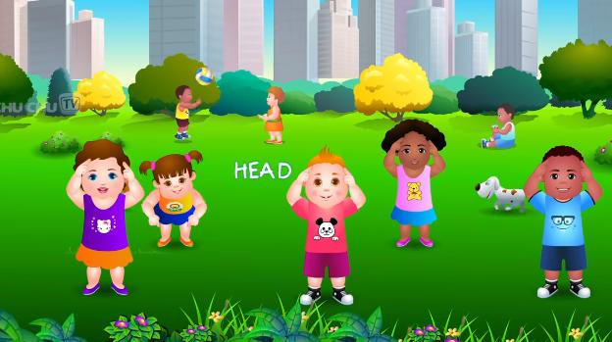

Let’s sing ‘’Head and shoulders, knees and toes!”
Head, Shoulders, Knees & Toes - Exercise Song For Kids - YouTube

Slide 5
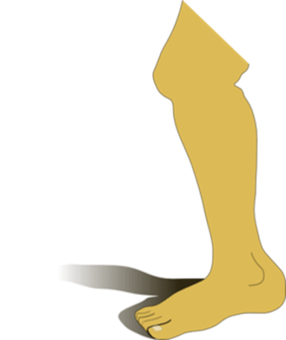
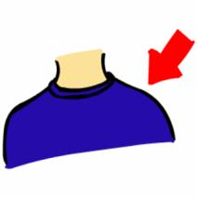


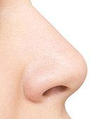

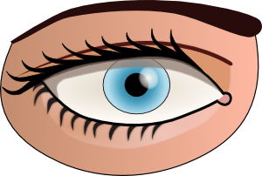

Listen, point and say!

Slide 6
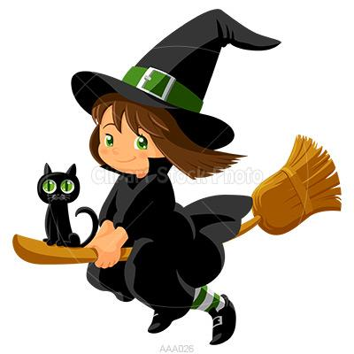
Hello, children! Remember me? I’m Mia Mia! Are you ready to play our game?

Slide 7

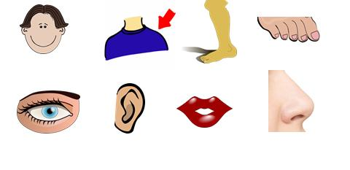
I throw magic dust!

Slide 8

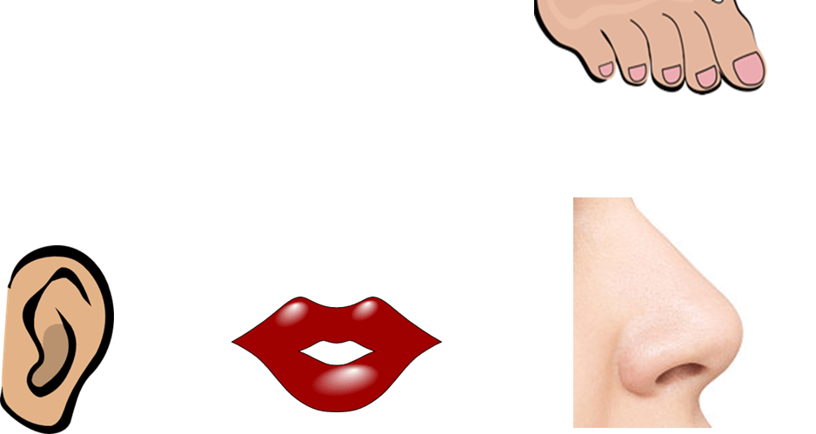
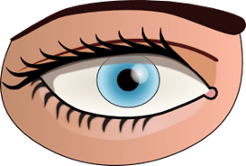
Open your eyes!
What is missing?

Slide 9


Slide 11
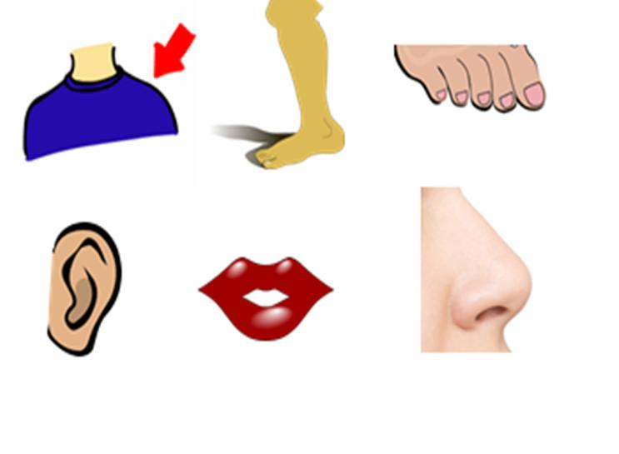
What is missing?

Slide 13
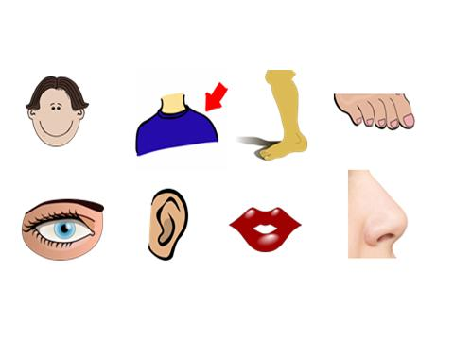

Slide 14
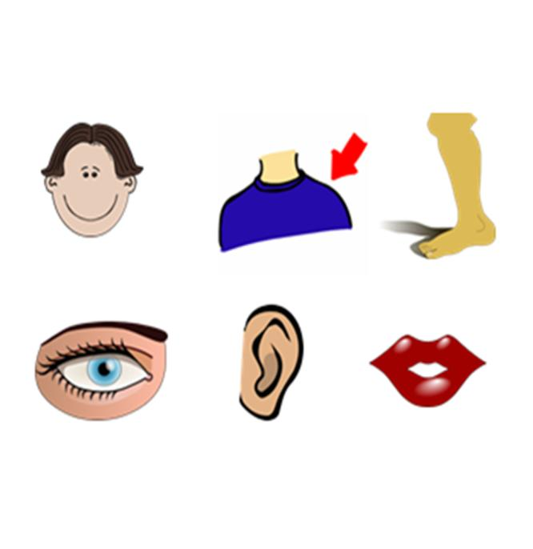
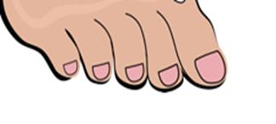
What is missing?

Slide 15


Slide 16

One last time! Level 2! Two words!

Slide 17
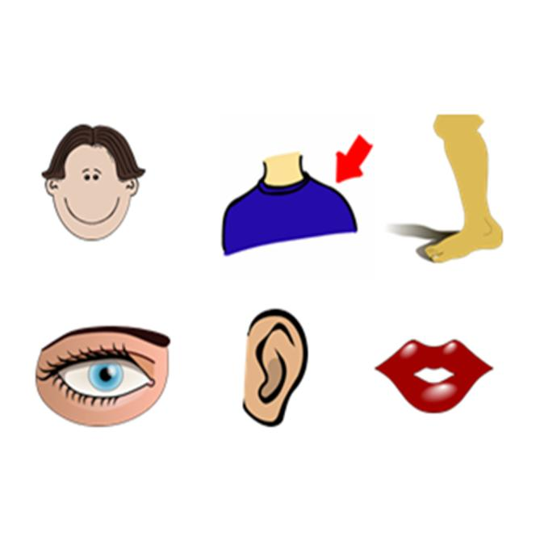
What words are missing?

Slide 18


Slide 19
Oh no! You won again! I ‘m going home!!!

Slide 20

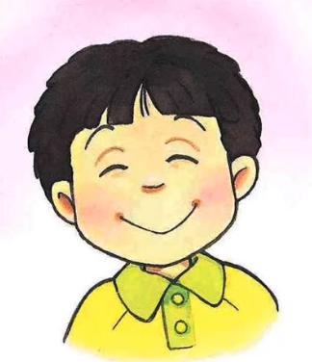
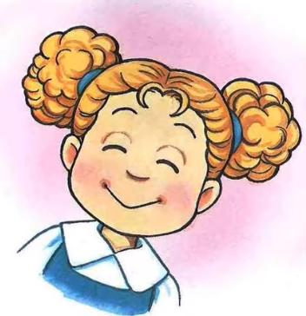
Eyes, nose, mouth and ears make a happy face! ☺
Eyes Nose Mouth Ears - Song - YouTube

Slide 21
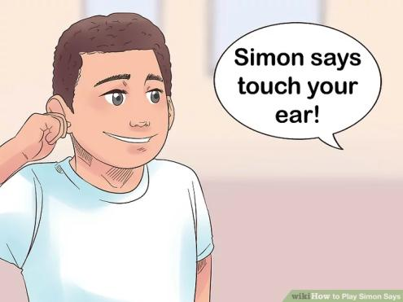
Hey! Let’s play “Simon says”!

Slide 22


Click and play a memory game!
http://www.quia.com/jg/3117194.html

Slide 23
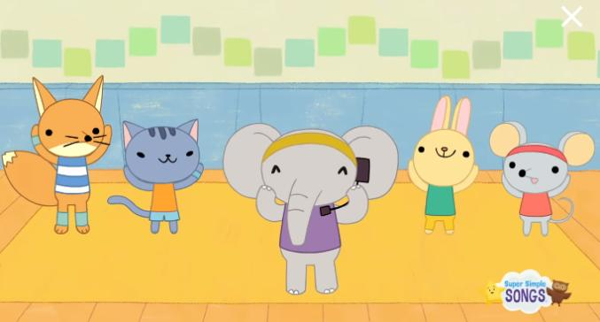
Can you sing “Head, shoulders, knees and toes” faster and faster and faster?
Head Shoulders Knees & Toes (Speeding Up) | Nursery Rhyme | Super Simple Songs - YouTube

Slide 24

GAME
Find the
right monster

Slide 25

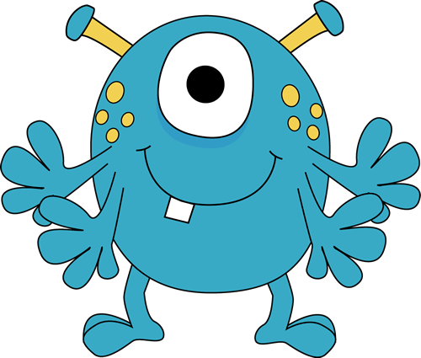
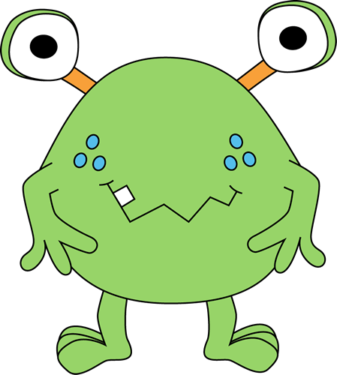
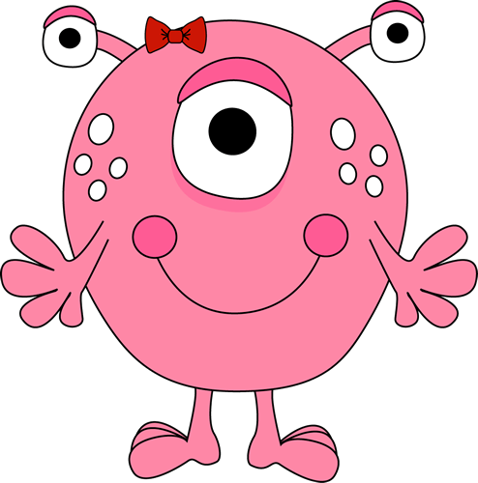
Listen and click on the right monster.

Slide 26


Slide 27



Slide 28
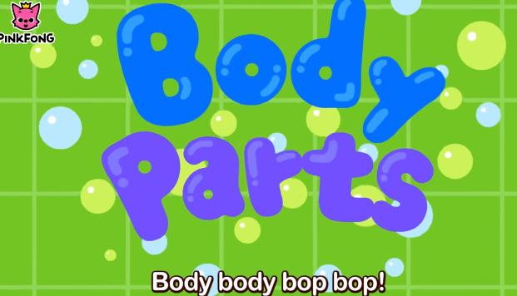
Let’s finish the lesson with a really funny song.
Hello, My Body! | Body Parts Songs | Pinkfong Songs for Children - YouTube

Slide 29

Well done!

Slide 30

http://www.clker.com
https://images.app.goo.gl/rdPYg7tRaJNjFsMg7
https://images.app.goo.gl/8Bfx5i28yNBJR3s18
http://clipart-library.com/

